Slide 1
Provisioning Domains
B. Bruneau, T. Pauly, P. Pfister, D. Schinazi, E. Vyncke
IETF 98, March 2017
Chicago, US

Slide 2
Provisioning Domain (PvD)
Configuration items for a node to access a network
PvD ID (similar to FQDN) to tag all PvD information
can be used to remove PvD information when PvD is expired/removed/..
Human readable (localized) name
Prefix, next-Hop router
Internet access is possible
Captive portal is present
Recursive DNS server, DNS search list
Maximum Throughput, latency
Financial cost structure
Time validity/refresh period of the PvD

Slide 3



Yes, that’s right. Choose your source address, I’ll make sure packets go down the right path.
“So, the source address I select affects the path and associated policy throughout the network?”
Yikes! What do I do! I’ve never asked the user for this kind of information before!
Credit: Mark Townsley

Slide 4

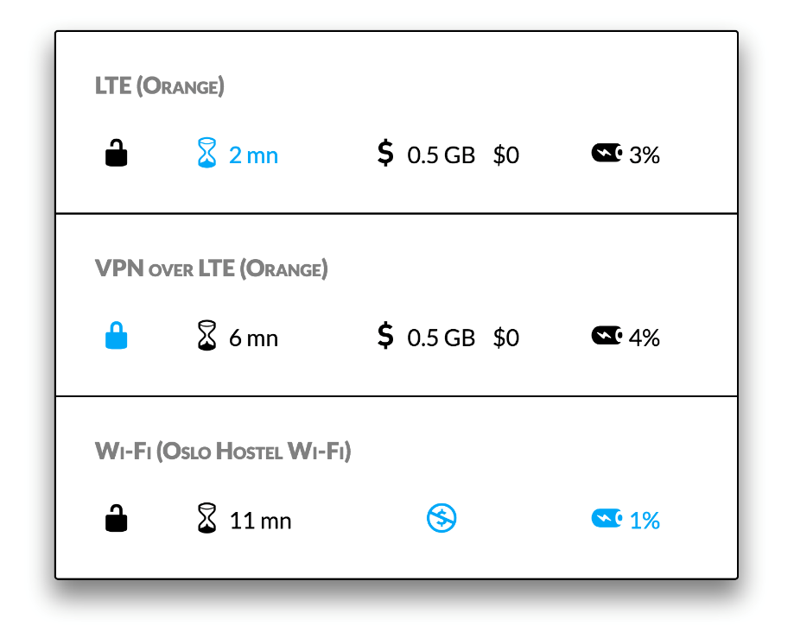
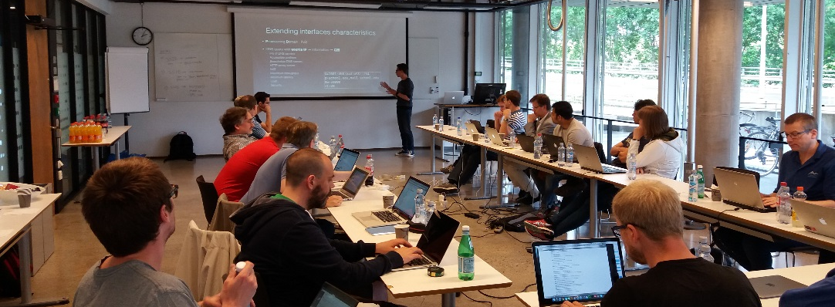
A New, Evolutive API and Transport-Layer Architecture for the Internet: https://www.neat-project.org/
European H-2020 project
10 partners (Cisco, Mozilla, EMC, Celerway…)
Asking the user to choose with relevant criteria and simple UI
Provisioning Domain (information about a prefix) via DNS draft-stenberg-mif-mpvd-dns-00 (old)
Integration to NEAT code: https://github.com/NEAT-project/neat/pull/80
Wednesday, June 29 2016: plenary session in Oslo
IPv6 Multiprefix NEAT Integration

Slide 5
How ?
Bootstrap PvD information added to IPv6 Router Advertisement
PvD applies to all Prefix Information Options (PIO)
Use multiple RA if the PvD is not to be shared among PIO
Bootstrap PvD ID may be used to retrieve additional PvD information
PvD obtained by IPv6 could be linked to IPv4
IPv4 prefix included in PvD
Link via the source MAC address of the RA w/ DHCPv4 message
Interface ID (such as 3GPP link)
DNS search list of DHCPv4 and IPv6 PvD

Slide 6
IPv6 Content Networking IETF Glass to Glass Internet Ecosystem (GGIE)
Client A
<IP_{CA}, *>
Server
<IP_{SA}, 80>
<IP_{SB}, 80>
…
<IP_{SZ}, 80>
Client A
<IP_{CZ}, *>
http://demo.6cn.solutions
One TCP connection per object (video chunks)
Building a kind of different transport layer ☺
Issue with SSL, QUIC is better (re-use of connection ID)

